Slide 1
Unit-VI: Startup Funding & Branding
Sources of Funding: Bootstrapping,
Angel Investors,
Crowd Funding,
Venture Capitalists,
Advantages of Crowd Funding,
Schemes of Government through Startup India,
Role of Institutional support and Commercial Banks.
Introduction to branding a startup and developing branding strategies.

Slide 2
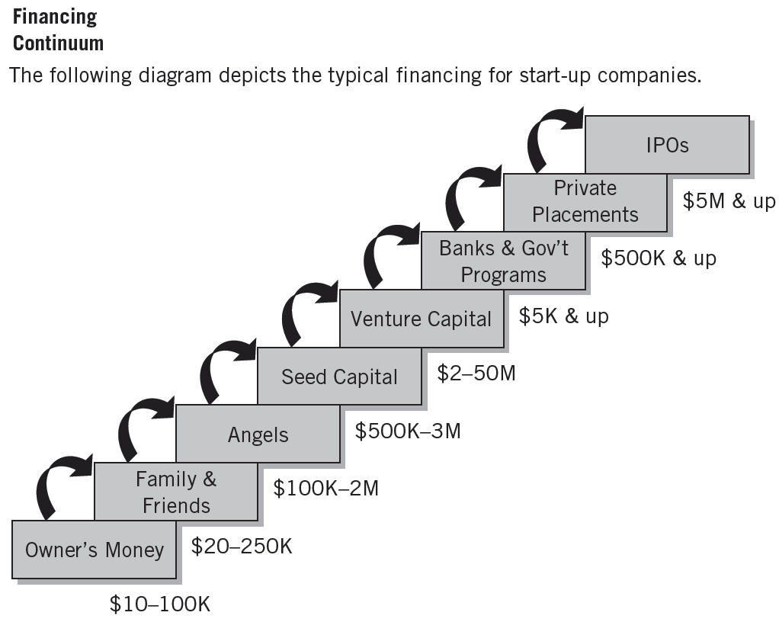

Sources of Funding Entrepreneurial Start-Up Companies?

Slide 3
Classification Source of Capital
Equity Sources:
Personal Sources
Private Borrowings
Informal Capital
Corporate Securities
Public Issues
Internal Financing
Debt Sources:
Debenture
Commercial Papers
Inter-corporate deposits
Public Deposits
Institutional sources
Commercial Banks
Non-Institutional Arrangements (Hire, Rent and Leasing)

Slide 4
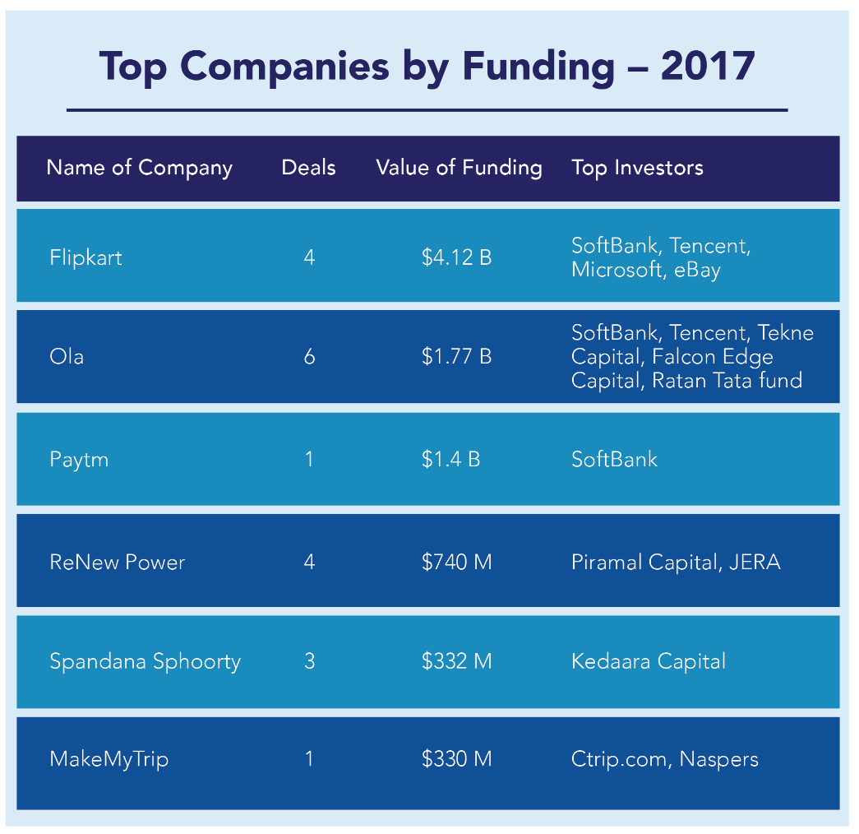

Slide 5
Bootstrapping
Bootstrap financing is probably one of the best and most inexpensive routes an entrepreneur can explore when raising capital.
Bootstrap financing is a way to pull yourself up without the help of others.
Number of Advantages:
Business will be worth more because less money has been borrowed.
Need not have to pay the high interest on borrowed money.
Creative in finding ways to raise profits, without having to look to external sources.

Slide 6
Source Of Bootstrap Financing
Source Of Bootstrap Financing
Trade Credit
Factoring
Customers
Real-estate
Equipment Suppliers
Conditional Sales Contract
Chattel Mortgage Contract

Slide 7
1. Trade-Credit Normally, a supplier will extend you credit after you're a regular customer for 30, 60 or 90 days, without charging interest.
Example, suppose that a supplier ships something to you, and that bill is due in 30 days but you have trade credit or terms.
Your terms might be net 60 days from the receipt of goods, in which case you would have 30 extra days to pay for the items.
2. Factoring
This is a financing method where you actually sell your accounts receivable to a buyer such as a commercial finance company to raise capital.
A "factor" buys accounts receivable, usually at a discount rate that ranges between one and 15 percent.

Slide 8
Factoring can be performed on a non-notification basis. That means your customers aren't aware that their accounts have been sold.
The factor then becomes the creditor and assumes the task of collecting the receivables as well as doing what would've been your paperwork chores.
3.Customers Customers are another source of bootstrap financing, and there are several different ways to take advantage of these valuable assets.
One way to use your customers to obtain financing is by having them write you a letter of credit.
Example, suppose you're starting a business manufacturing industrial bags. A large corporation has placed an order with your firm for a steady flow of cloth bags.

Slide 9
The major supplier from which you will obtain the material the bags is located in India.
In this scenario, you obtain a letter of credit from your customer when the order is placed, and the material for the bags is purchased using the letter of credit as security.
4.Realestate Another bootstrap financing source is real estate.
The first is simply to lease your facility.
This reduces startup costs because it costs less to lease a facility than it does to buy one.
Also, when negotiating a lease, you may be able to arrange payments that correspond to seasonal peaks or growth patterns.

Slide 10
5. Equipment Suppliers
Instead of paying out cash for your equipment, you can purchase it with a loan from manufacturers;
In this way, equipment suppliers are a source of bootstrap financing.
Two types of credit contracts are commonly used to finance equipment purchases:
1. The conditional sales contract, in which the purchaser does not receive title to the equipment until it is fully paid for.
2. The chattel-mortgage contract, in which the equipment becomes the property of the purchaser on delivery, but the seller holds a mortgage claim against it until the amount specified in the contract is paid.

Slide 11

Angel Investors
A wealthy individual willing to invest own money in a business start-up. The term Angel investor was first used by William Wetzel .
An angel investor or angel (also known as a business angel, informal investor, angel funder, private investor, or seed investor) is an affluent individual who provides capital for a business start-up, usually in exchange for convertible debt or ownership equity.
Top Angel Investor in India
Rajan Anandan:
Anupam Gopal Mittal:
Sanjay Mehta:
Zishaan Hayath:
Sharad Sharma:
Anand Ladsariya:
Sunil Kalra

Slide 12
Investment Profile Angel Investors
Investment Profile
Angel investments bear extremely high risks As such, they require a very high return on investment.
A large percentage of angel investments are lost completely when early stage companies fail, professional angel investors seek investments that have the potential to return at least ten or more times their original investment within 5 years, through initial public offering or an acquisition.
Current 'best practices' suggest that angels might do better setting their sights even higher, looking for companies that will have at least the potential to provide a 20x-30x return over a five- to seven-year holding period.
The actual effective internal rate of return for a typical successful portfolio of angel investments is, in reality, typically as 'low' as 20– 30%.

Slide 13
India Angel Network Achievement
India Angel Network achievement
Largest Angel investor group spread PAN India geographically in Mumbai, Delhi, Pune and Bangalore.
+125 active Angel investor from across India and overseas.
Concept has found resonance with corporate like IBM, venture fund like SIDBI,IVP,RVCF etc.
+22 investments made to date across multiple sectors
+250 deals received per month pan India bases
Co investment with Sequoia Capital in Dhruva
Member of world business Angel investor Association

Slide 14
Crowd Funding
Accumulation of small investments in individual projects by large number of individuals (the “crowd”) via or with help of Internet and social networks.
“the collective effort of individuals who network and pool their money, usually via the Internet, to support efforts initiated by other people or organizations.”
Most crowd funding platforms specialize or focus on a specific area such as art, business or charities.
Examples
Crowd funder (specializes in business and tech start-ups)
Crowd rise (funds charities & causes)
Quirky (funds for inventors)
Invested.in (to create your own funding community)
Indiegogo (no specialization)

Slide 15
Advantages Of Crowd Funding Need to be Creative
The advantages of crowd funding as a way of financing a project depends really on the type of the crowd funding itself.
Types of Crowd Funding
Rewards
Debt
Donation
Equity

Slide 16
1. Rewards-based, This type of crowd funding is likely to attract patrons, who invest because they enjoy your project or initiative and want to support it. The most popular reward-based sites are Kickstarter and Indiegogo.
Main advantage: you won’t launch your venture in debt (like in debt-based crowd funding),or give out shares of your project to patrons (like in equity-based crowd funding)
2. Donation-based, This type of fundraising is typical for a non-profit or a cause. Example : Go found me.
Main advantage: same as with rewards-based model, you don’t need to take a loan to launch your project.

Slide 17
3. Equity-based, This type of crowd funding is aimed towards technological, industrial and professional businesses and services rather than other causes. Examples of equity crowd funding aimed sites are Crowd cube, Fundable, Seedrs, and Fig.
Main advantage: you will be able to collect a larger amount of money, that will allow you to launch your business, and do it without taking credit.
4. Debt-based, also known as peer-to-peer (P2P). It is like a credit from the bank, but instead of borrowing one larger amount of money, you borrow smaller amounts from multiple people. Examples of debt-based crowd funding platforms are Funding Circle and Zopa.
Main advantage: There is no need to apply for a loan and go through the bank paperwork as well as to have a strict, demonstrable credibility that bank requires

Slide 18

Venture Capitalists
They provide capital to young businesses in exchange for an ownership share of the business.
The SEBI defined Venture capital fund in its regulation 1996 as a fund established in the form of a company or trust which raises money through loans, donations, issues of securities of units as the case maybe and makes or proposes to make investments in accordance with regulations.
A venture capitalist is a person or investment firm that makes venture investments and these venture capitalists are expected as well as capital to their investments.
Characteristics of VCs
Well managerial skills
Well knowledgeable
Sophisticated investors-Comes forward to take risks
Decision making ability
Analyzing skills

Slide 19
Services generally provide by VCs
Finance to new and rapidly growing firms
Finance to typically knowledge based sustainable up scalable companies
Purchase equity and quasi equity securities
Assist in the development of new products or services
Add value to the company through active participation
Advantages of VC’s | Dis – Advantages of VC’s
Economy Oriented | Lengthy and Complex process
Investor Oriented | Deal in the negotiation
Entrepreneur Oriented | Investors becomes parts of owner’s business.

Slide 20
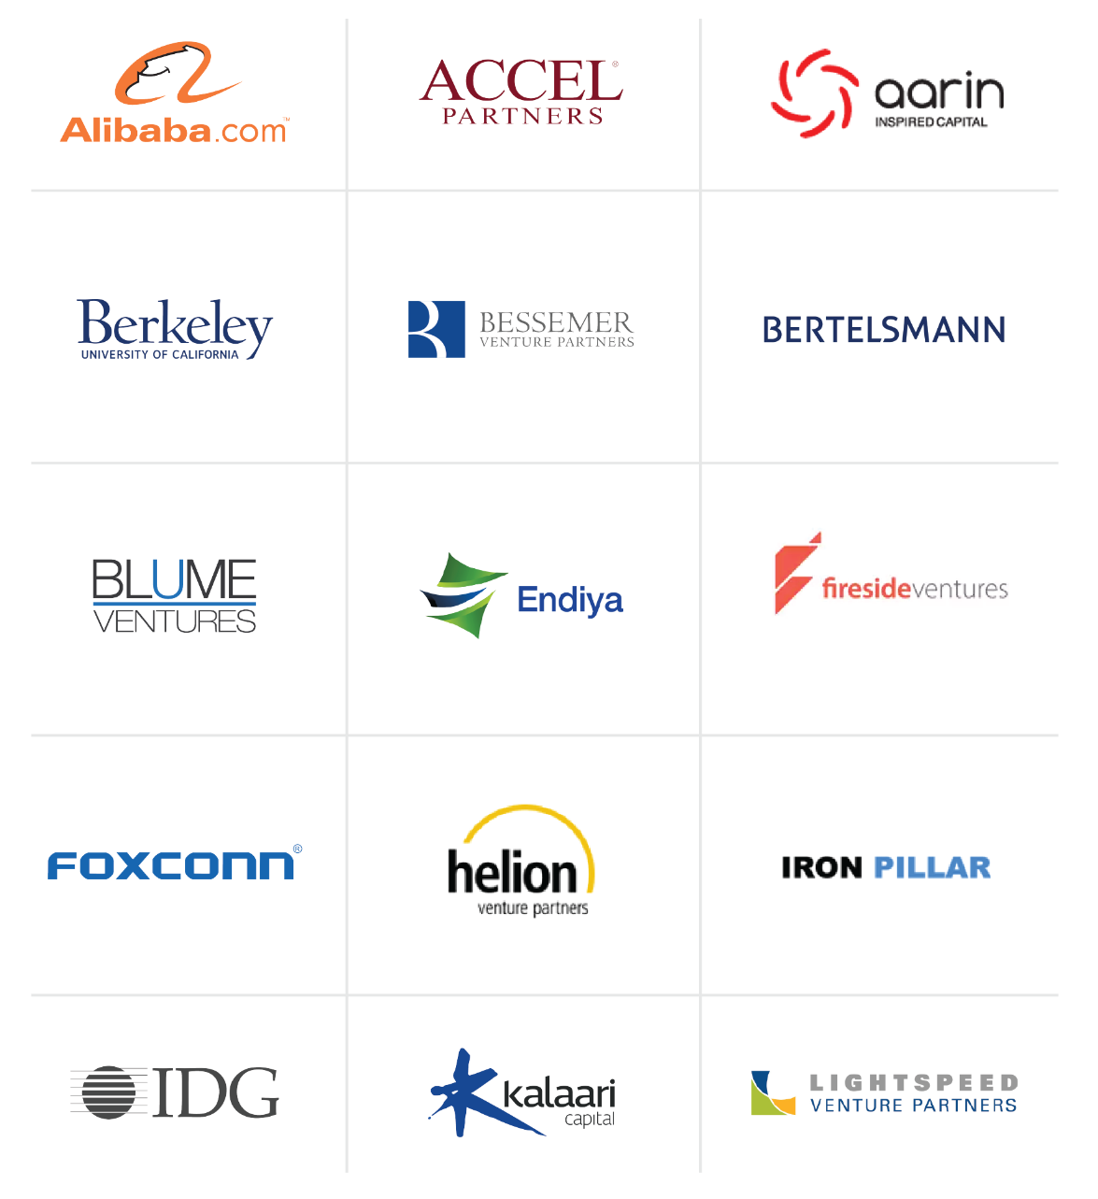
The most active Venture Capital Funds in India

Slide 21

The most active Venture Capital funds in India

Slide 22
Role of Institutional Support and Commercial Banks.
Fiancé is considered as life blood of business. But it is beyond the capacity and capability of any single individual to contribute the required capital for the purpose.
The need for Institutional Support is discussed as follows:
1. To prepare project profiles and feasibility on behalf of entrepreneur.
2. To undertake industrial potential surveys with a view to provide first hand information regarding raw material, required labor etc.
3. To identify potential entrepreneurs and provide the technical and managerial assistance.
4. To undertake market researches and surveys for specific products, so that in future the unit may not take any difficult in marketing products.

Slide 23
5. To undertake export consultancy for export oriented projects based on modern technology to facilitate export.
6. To conduct entrepreneurship development programmes with a view to aware, create and groom entrepreneurs.
7. To procure and distribute scare raw materials as and when required.
8. To supply machinery on hire purchase system.
9. To render marketing assistance to small-scale industries with a view to effectively sell their products in competitive era.

Slide 24
10. To provide consultancy and trading services to strength the competitive ability and gain advance knowledge in the field.
11. To help in development and up graduation of technology and implementation of modernization programmes by replacing old and outdated equipments.
12. To undertake the mass construction of industrial estates with all basic facilities.
13. To provide infrastructure and accommodation facilities to the entrepreneurs.

Slide 25
INSTITUTIONAL SUPPORT
The National Small Industries Corporation Ltd (NSIC)
State Small Industries Development Corporations (SSIDC)
District Industries Centers (DIC)
Small Industries Development Bank Of India (SIDBI)
Khadi and Village Industries Commission

Slide 26
1. The National Small Industries Corporation Ltd (NSIC)
The National Small Industries Corporation Ltd (NSIC) was set up in 1955 as central government undertaking, the main aim of which is to fulfill the requirement of machinery and equipment for the development of the small entrepreneurs.
Provides financial assistance by way of hire-purchase scheme for purchase of machinery and equipment, required for the setting up industries.
Provides various equipments on lease basis and training to workers.
Assists in marketing and exporting of the products of SSIs.
Helps in the development and up gradation of technology and modernization of the industries. Undertakes construction of industrial estates.
Purchase huge quantity of important raw materials and distribute the same to SSIs at reasonable rates.
Develops prototype machines and equipments to pass on to SSIs for commercial production. Sets up small scale industries in other developing countries on turn-key basis.
Functions

Slide 27
2. State Small Industries Development Corporations (SSIDC)
The State Small Industries Development Corporation (SSIDC) was set up under the companies act 1956, as state government undertakings to cater to the primary development needs of the small tiny and village industries in the state/union territories under their jurisdiction.
To procure and distribute scarce raw materials.
To supply machinery on hire purchase system.
To provide assistance for marketing of the products of small-scale industries.
To construct industrial estates/sheds, providing allied infrastructure facilities and their maintenance.
To extend seed capital assistance on behalf of the state government concerned provide management assistance to production units.
Functions

Slide 28
3. DISTRICT INDUSTRIES CENTERS (DIC)
The District Industries Centers (DICs) programming was started in 1978 with a view to provide integrated administrative framework at the district level for promotion of small scale industries in rural areas.
To prepare and keep model project profiles for reference of the entrepreneurs.
To prepare action plan to implement the scheme effectively already identified.
To undertake industrial potential survey and to identify the types of feasible ventures which can be taken up in ISB sector, i.e., industrial sector, service sector and business sector.
Functions

Slide 29
4. To guide entrepreneurs in matters relating to selecting the most appropriate machinery and equipment, source of it supply and procedure for importing machineries.
5. To provide guidance for appropriate loan amount and documentation.
6. To assist entrepreneurs for availing land and shed equipment and tools, furniture and fixture.
7. To appraise the worthiness of the project-proposals received from entrepreneurs.
8. To help the entrepreneurs in obtaining required licenses/permits/clearance.
9. To assist the entrepreneurs in marketing their products and assess the possibilities of ancillarization.
10. To conduct product development work appropriate to small industry.
11. To help the entrepreneurs in clarifying their doubts about the matters of operation of bank accounts, submission of monthly, quarterly and annual returns to government departments.

Slide 30
4. Small Industries Development Bank Of India (SIDBI)
The government of India has set up the Small Industries Development Bank of India (SIDBI) under Special Act of Parliament in 1989 as a wholly owned subsidiary of the IDBI for ensuring larger flow of financial and nonfinancial assistance to the small scale sector.
The SIDBI has taken over the outstanding portfolio of the IDBI relating to the small scale sector.
The important functions of IDBI are as follows:
(1) To initiate steps for technological up gradation and modernization of exciting nits.
(2) To expand the channel for marketing the products of SSI sector in domestic and international markets.
(3) To promote employment oriented industries especially in semi-urban areas to create more employment opportunities and thereby checking migration of people to urban areas.

Slide 31

5. Khadi and Village Industries Commission
The Khadi and Village Industries Commission (KVIC) is a statutory body formed by the Government of India, under the act of Parliament, ‘Khadi and Village Industries Commission Act of 1956’.
It is an apex organization under ministry of micro, Small Medium Enterprises (Govt. of India), with regard to khadi and village industries within India, which seeks to – “plan, promote, facilitate, organize and assist in the establishment and development of khadi and village industries in the rural areas in coordination with other agencies engaged in rural development wherever necessary.”
In April 1957, it took over the work of former All India Khadi and Village Industries Board.

Slide 32
Commercial Banks.
Types of Bank Loans (Asset based)
Accounts receivable loans.
Inventory loans.
Equipment loans.
Real-estate loans.
Cash flow financing (Conventional bank loans)
Installment loans.
Straight commercial loans.
Long-term loans.
Character loans.

Slide 33
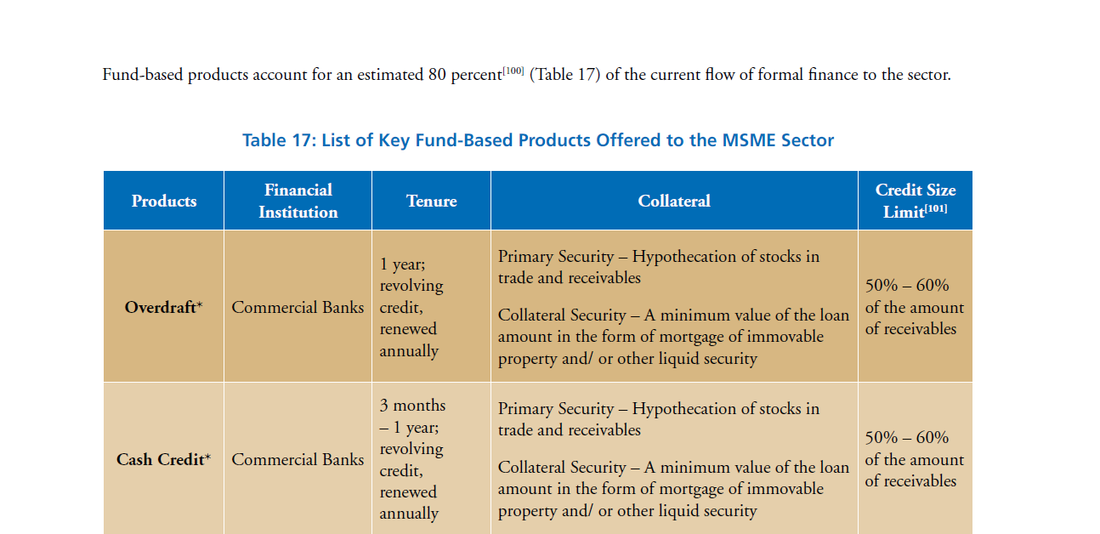

Slide 34
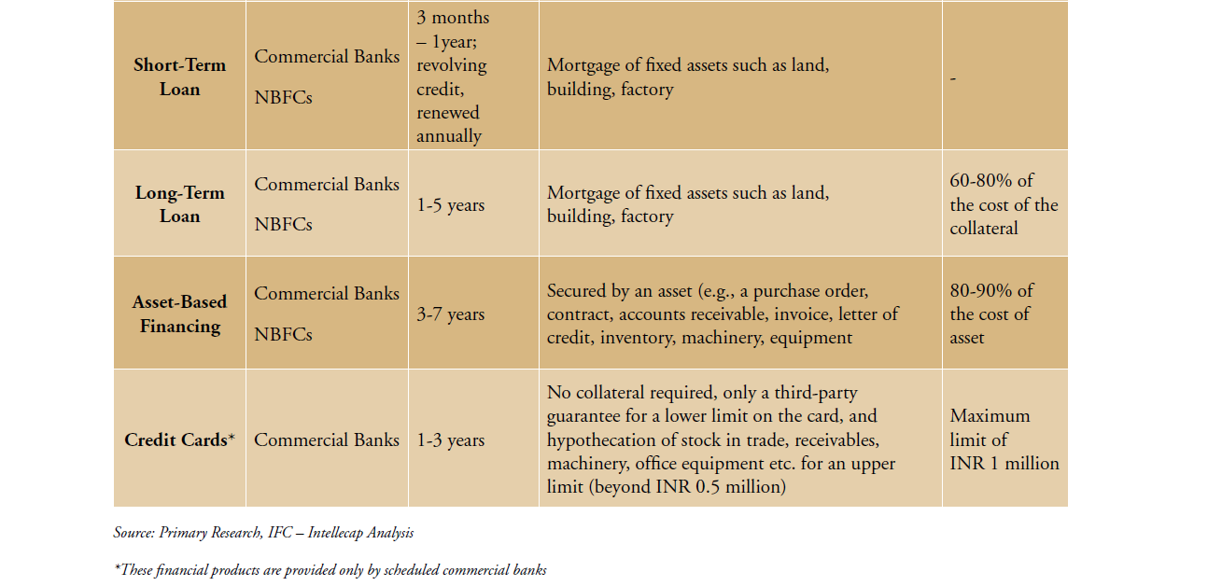

Slide 35
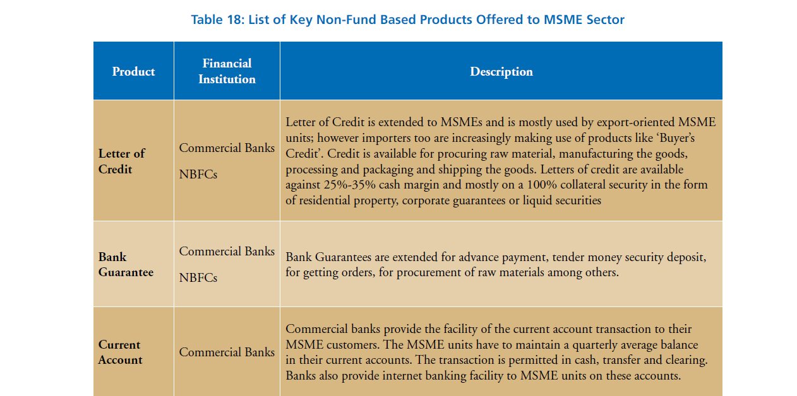

Slide 36
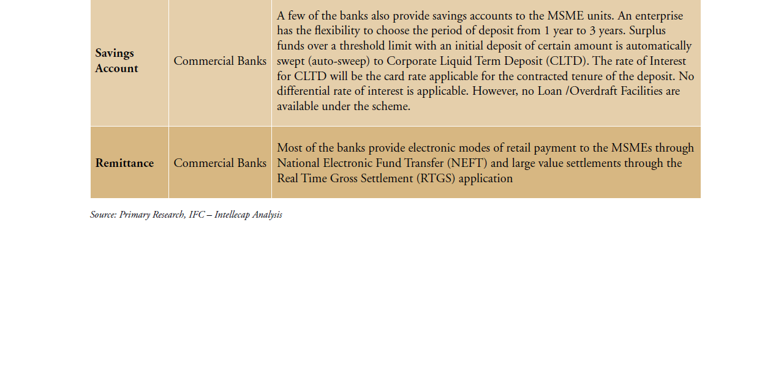

Slide 37

Schemes of Government through Startup India,
Funding Support: Fund Of Funds With a Corpus of INR 10,000 Crores.
The Fund will be in the nature of Fund of Funds, which means that it will not invest directly into Startups, but shall participate in the capital of SEBI registered Venture Funds.
The Fund of Funds shall be managed by a Board with private professionals drawn from industry bodies, academia, and successful Startups.
Life Insurance Corporation (LIC) shall be a co-investor in the Fund of Funds
The Fund of Funds shall contribute to a maximum of 50% of the stated fund size. In order to be able to receive the contribution, ◦ the enterprise should have already raised the balance 50% or more of the stated fund size

Slide 38
Credit Guarantee Fund for Startups
Debt funding to Startups is also perceived as high risk and to encourage Banks and other Lenders to provide Venture Debts to Startups.
Credit guarantee mechanism through National Credit Guarantee Trust Company (NCGTC)/ SIDBI is being envisaged with a budgetary Corpus of INR 500 crore per year for the next four years.
Tax Related Incentives for START UPS: Tax Exemption to Startups for 3 years
It is imperative that the profits of Startup initiatives are exempted from income-tax for a period of 3 years.
This fiscal exemption shall facilitate growth of business and meet the working capital requirements during the initial years of operations. .

Slide 39
SETTING UP INCUBATORS: An incubator is essentially a place, especially with support staff and equipment, made available at low rent to new small businesses.
35 new incubators in existing institutions: Funding support of 40% (subject to a maximum of INR 10 crore) shall be provided by Central Government for establishment of new incubators for which 40% funding by the respective State Government and 20% funding by the private sector has been committed.
The incubator shall be managed and operated by the private sector.
35 new private sector incubators: A grant of 50% (subject to a maximum of INR 10 crore) shall be provided by Central Government for incubators established by private sector in existing institutions. The incubator shall be managed and operated by the private sector.

Slide 40
Introduction to branding a startup and developing branding strategies.
Branding is one of the most important aspects of any business, large or small, retail or B2B.
“ Your brand is your promise to your customer”.
Defining your brand is like a journey of business self-discovery. It requires, at the very least, that you answer the questions below:
What is your company's mission?
What are the benefits and features of your products or services?
What do your customers and prospects already think of your company?
What qualities do you want them to associate with your company?

Slide 41
Branding Tips For A Startup
1 | Get a great logo | Place it everywhere.
2 | Write down your brand messaging. | Every employee should be aware of your brand attributes.
3 | Integrate your brand | How you answer your phones, what you or your salespeople wear on sales calls, your e-mail signature, everything.
4 | Create a "voice" for your company that reflects your brand. | Written communication
5 | Develop a tagline. | Write a memorable, meaningful and concise statement that captures the essence of your brand.
6 | Design templates and create brand standards for your marketing materials. | Use the same color scheme, logo placement, look and feel throughout.
7 | Be true to your brand. | If you don't deliver on your brand promise. refer you to someone else-

Slide 42
Developing Branding Strategies
Brand development is the process of creating and strengthening your professional services brand. As we help firms develop their brands, we divide the process into three phases.
The first phase is getting your brand strategy right and aligned with your business objectives.
Second is developing all the tools you will need to communicate the brand, such as your logo, tagline and website.
Finally, there is the phase of strengthening your newly developed or updated brand.

Slide 43
Branding Strategies
Product Branding/Multi-Brand strategy
Line Branding
Range Branding / Mixed Branding
Umbrella Branding Strategy
Source / Double Branding
Endorsement Branding
Private Labels / Store branding

Slide 44
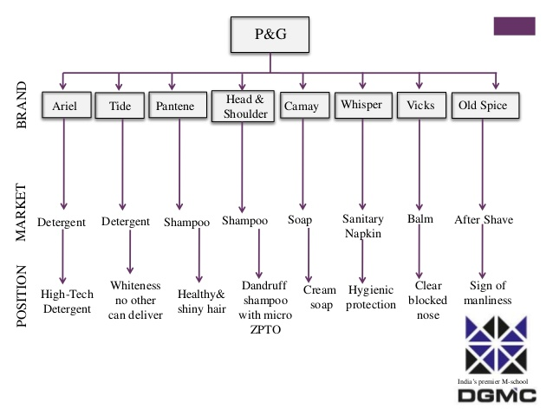
1.Product Branding/Multi-Brand strategy
In multi-branding strategy the brand is Promoted exclusively so that it acquires its own identity and image and stand on its own. Allowed to acquire differentiation and exclusivity
Targeted accurately to a distinct target market or customers because its positioning can be precise and unambiguous

Slide 45
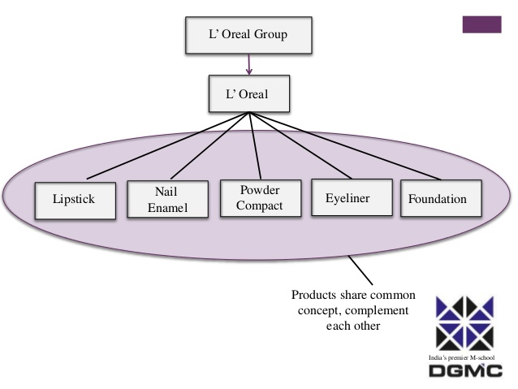
2. Line Branding
Line in the context of product mix refers to various product lines that a firm may have in its total portfolio.
For example: Philips – line extension has T.V, video and audio, personal care, communication and household appliances.
The brand appeals to distinct market segments who appreciate and like the brand. Now the customers do not tend to be contended with one product which the brand offers
Line extension is generally followed for complimentary products.

Slide 46
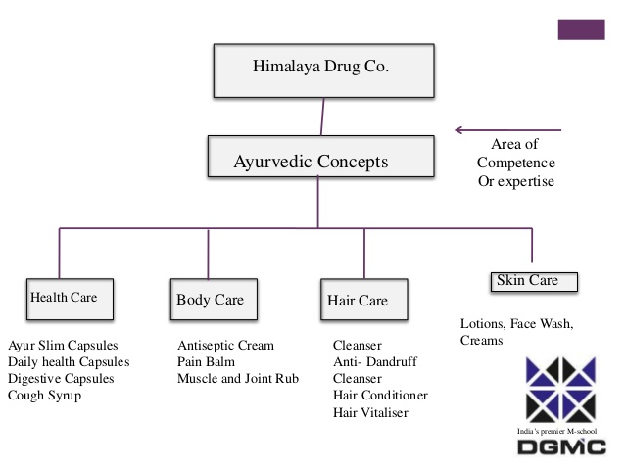
3. Range Branding / Mixed Branding
Line branding restricts the brand’s expansion into nearby territories of complementary products, which complement or support the main product’s usage
All the products share a common promise which stems from the firm’s or range brand’s area of competence
The product are tied together by a single brand concept
Example: Nestle uses its Maggi brand for its range of fast food – Maggi noodles, sauces, soups, pastas,etc

Slide 47
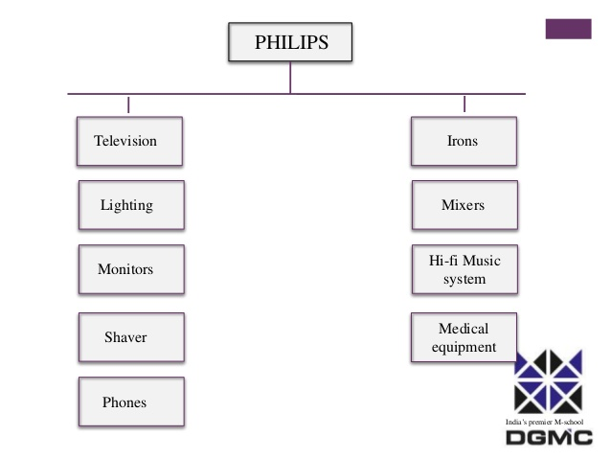
4. Umbrella Branding Strategy
Umbrella branding has been particularly favored by the companies of the East.
Example:
Korean giant LG uses its name on the product like microwaves, refrigerators, computers, television, air conditioners
Philips, GE and Canon also follow umbrella branding
Indian business houses – TATA and Bajaj

Slide 48
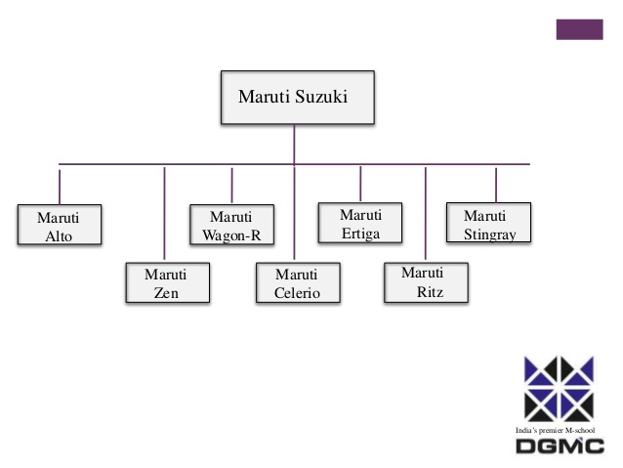
5. Source / Double Branding
Source brand strategy combines the firm’s name with the product brand name. It is hybrid of umbrella brand and product brand strategy
The product is given a brand name and it is combined with the name of the firm
Example:
Pulsar – name of the bike
Bajaj – the company name behind it
Both the name enjoys equal importance and are given equal status in the brand’s communication

Slide 49
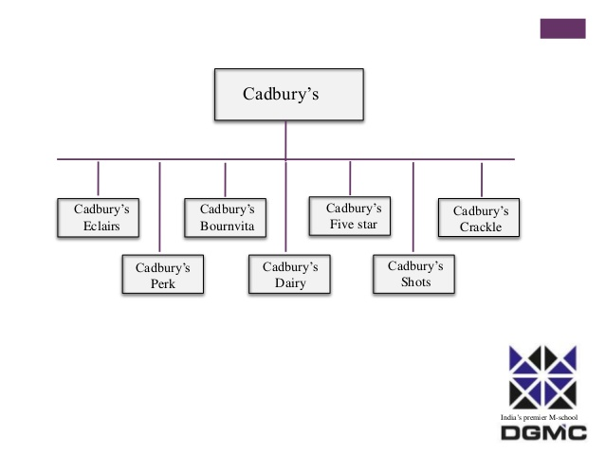
6. Endorsement Branding
Endorsement brand strategy is modified version of double branding
It makes the product brand name more significant and the corporate brand name is relegated to a lesser status
The umbrella brand is made to play an indirect role of passing on certain common generic associations
It is only mentioned as an endorsement to the product brand
By a large, the brand seeks to stand on its own
Unlike the product brand, endorsement brand discloses the identity of the maker, making it a small part of the brand

Slide 50
7. Private Labels / Store branding
Products marketed by retailers and other members of the distribution chain
Private labels can be called store brands when they actually adopt the name of the store itself in some way
Example: Stop brand of clothes by Shopper’s Stop

Slide 51


